Slide 1



i4TS
(Innovation for Telangana State)
Saralamaina Jivithaniki Samajika Avishkaranalu

Slide 2
FARMER KING !!
Email: harshavardhan538421@gmail.com
contact:7569486591
Agriculture is our wisest pursuit.
WE ARE FARMER KING:
The technological organization where farmers get their complete need for farming and trends of farming markets and making it one of the highest economy part of the India
Bring growth, ingenuity, and experience to market.

Slide 3

OUR VISION
Our vision is…
To improve the agriculture technology for the farmers using IOT and ML to improve and understand the market trends develop their crop .We also make direct selling of goods from farmers in online platform and offline form so that they can get the maximum price for what they grow.
Keep the farmer the first in agriculture sector . All these things are done by our application using AI and ML in it.

Slide 4




Sample
THE PROBLEM
NO ACCESS TO FARMING TECHNOLOGY:
Countries like many are moving their agriculture sector to the technological side but we are in the past 19th century with same technology and same reasons no knowledge about improving it
1.TOP 4TH IN AGRICULTURE PRODUCTION
2.NO IMPROVEMENT OF TECHNOLOGY
2.ONE OF THE HIGHEST GDP OF AL TIME 18%
3.MORE THAN 50% EMPLOYED IN FARMING
4.BUT MORE NO OF SUICIDES IN THE SAME COUNTRY
5.NO GRADUAL GROWTH SINCE MANY YEARS
NO KNOWLEDGE OF CROP HEALTH AND WEATHER:
As most of the farmers are not highly educated they use pesticides and more for high crop so that spoils the health of crop and no warning weather to save their crops
MEDIATORS AND RESELLING:
Due to more number of mediators the farmers getting least price for their crop and sometimes leaving the crop when they don’t get the mariginal amount

Slide 5
THE SOLUTION
The FARMER KING!! is an organisation where we provide online and offline platforms for selling the goods which are directly taken from the farmers to give them high profits with no mediators.
Analysing the crop health and giving them a report using machine learning and artificial intelligence
Mediators reduction
Weather reports and market trends reports
Knowing them regarding the government policies
Complete support for the farmers who collaborated with the farmer king

Slide 6
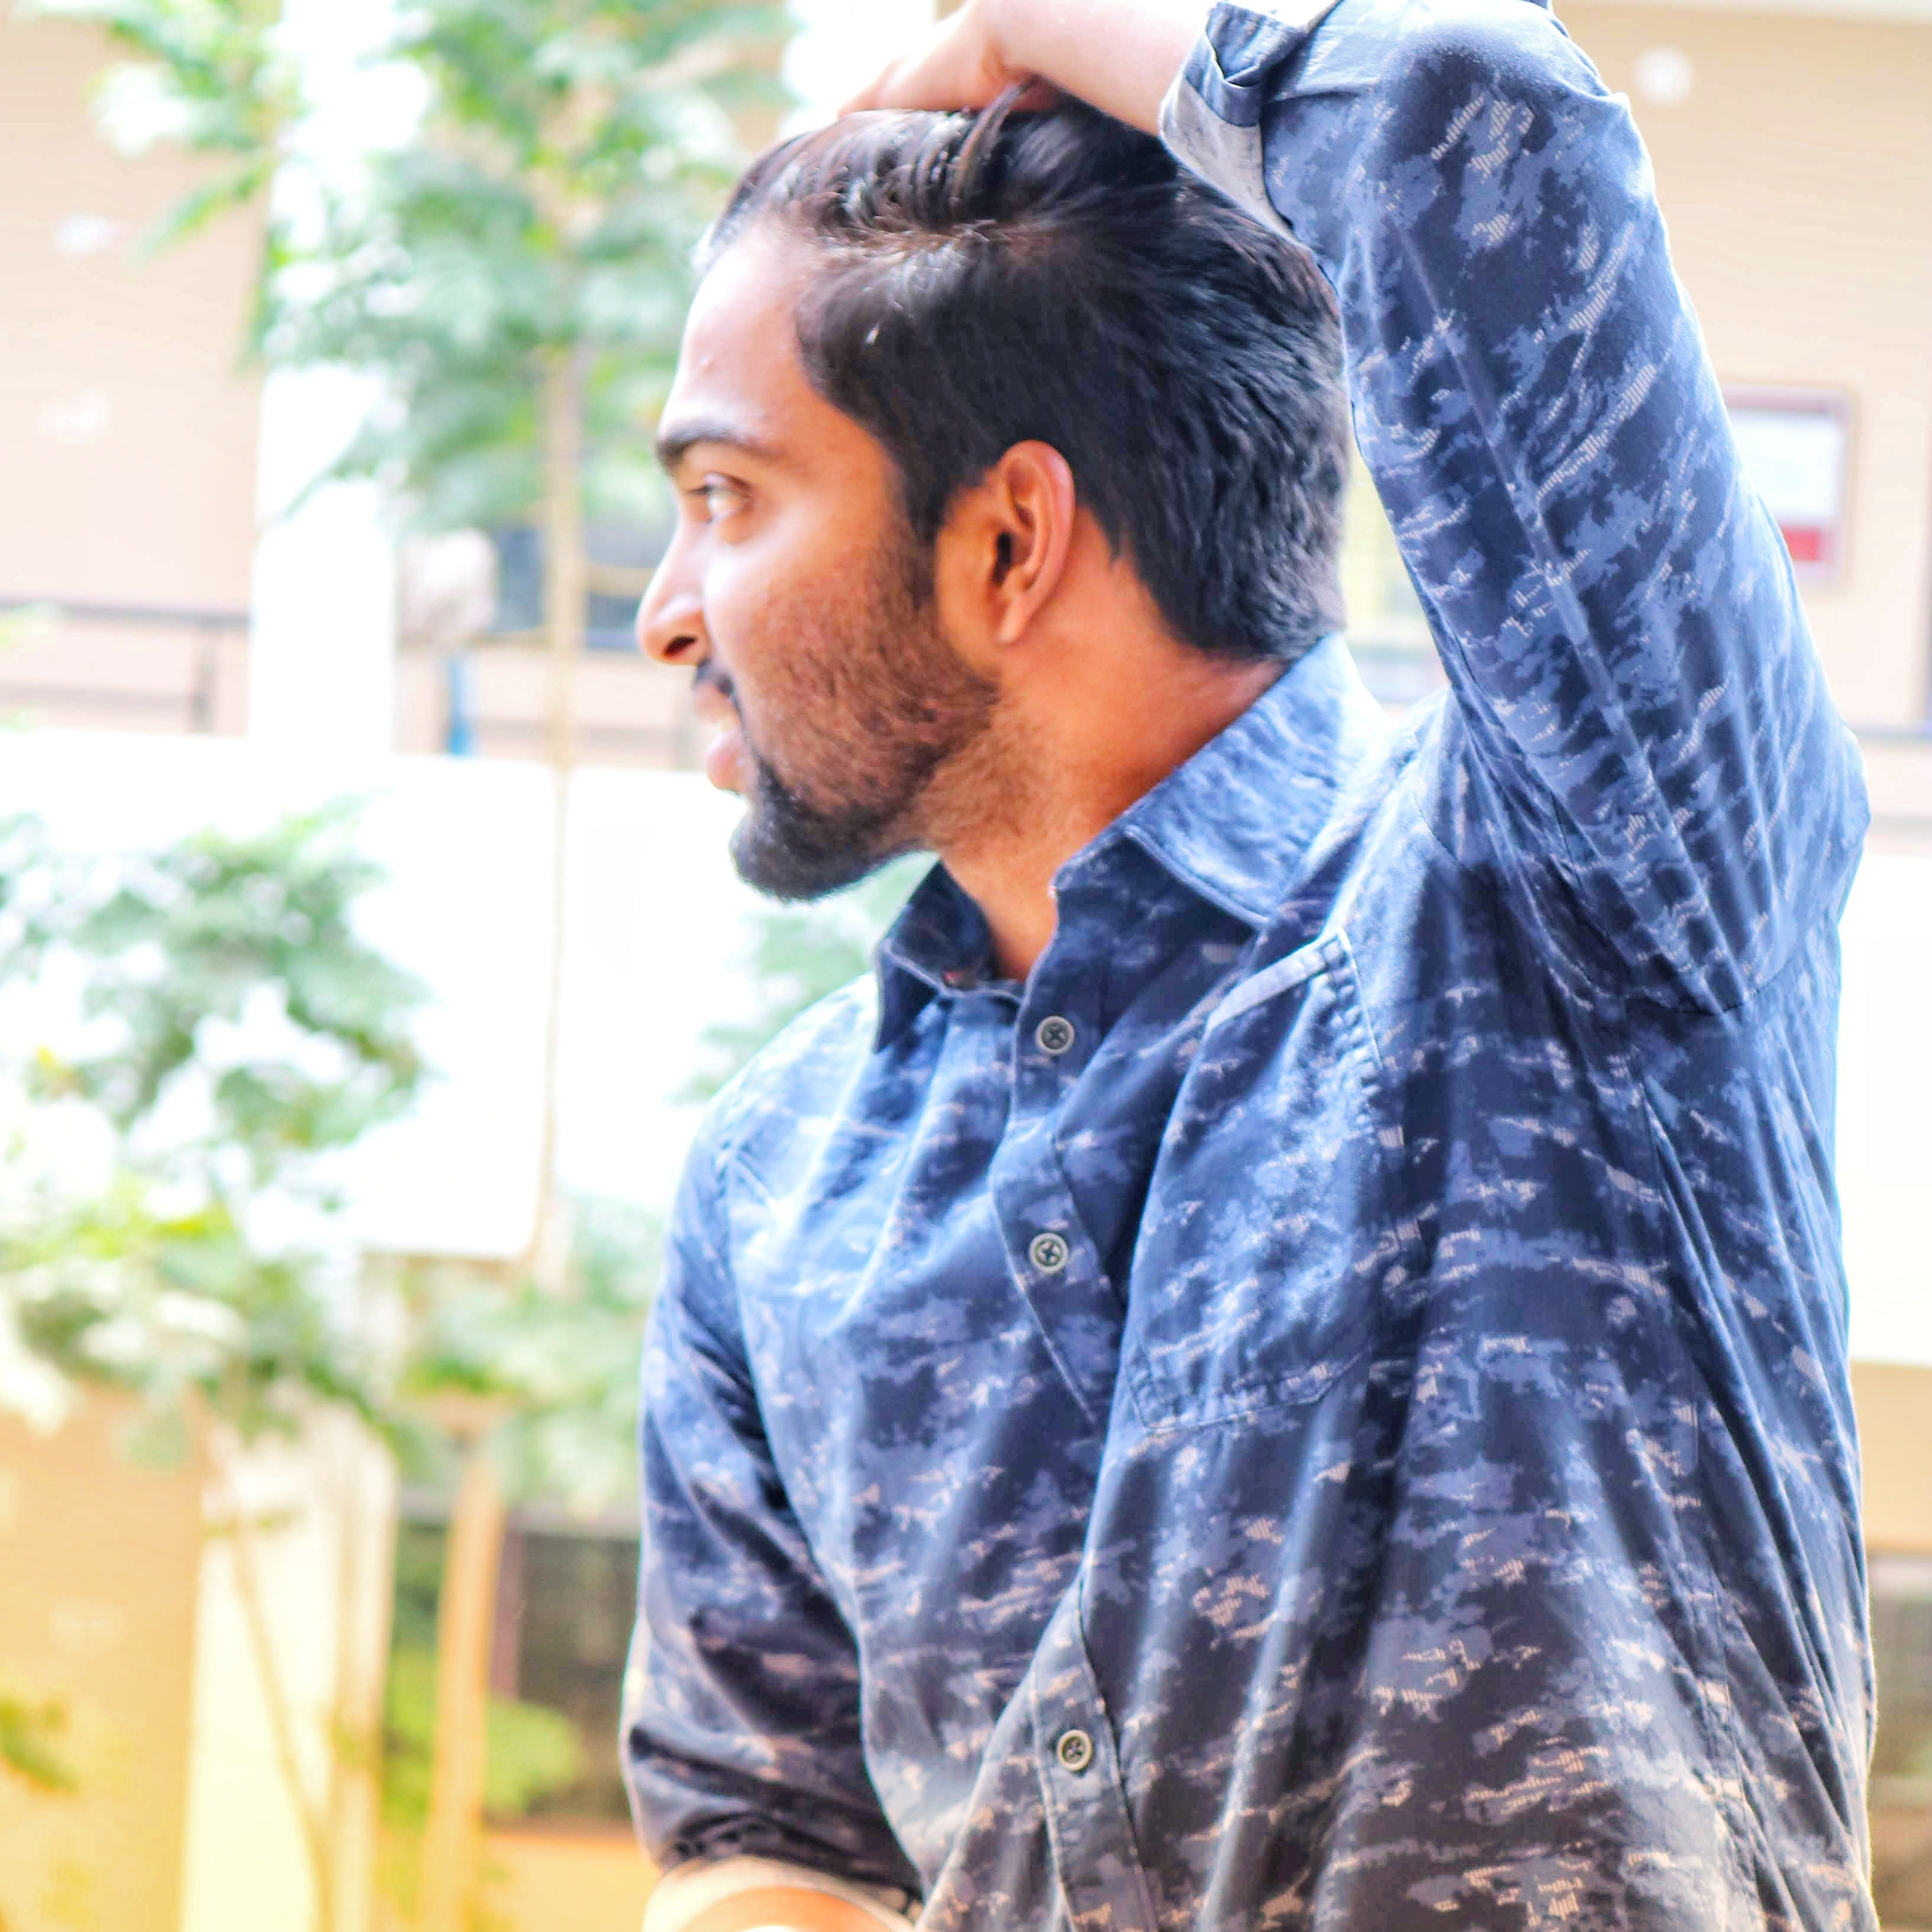
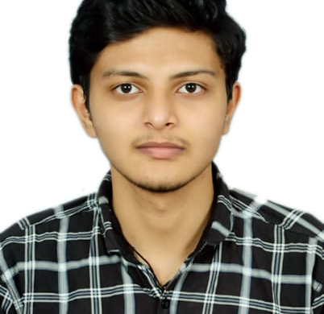
THE TEAM
HARSHAVARDHAN
KANDLAKUNTA
ANOOP
MOMULA
MACHINE LEARNING AND MARKET TRENDS MANAGEMENT
SOFTWARE DEVELOPMENT AND APPLICATION MANAGEMENT

Slide 7
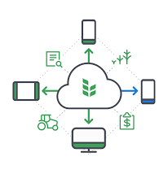
FARMER KING
Bringing the farming growth technically and making the agriculture sector one of the proud and profitable one.
TAGLINE
Name :K Harshavardhan.
M Anoop.
Email :harshavardhan538421@gmail.com
phone contact:7569486591

